Slide 1

ASSIGNMENT
Requirement life cycle for customer segmentation model for a Telecommunication Company.
NAME-Sasmita Sabat

Slide 2
Introduction
Requirement Elicitation
Requirement Analysis
Requirement Specification
Requirement Validation
Requirement Implementation
Requirement Testing
Requirement Review and Feedback
Requirement Maintenance and Evolution
Requirement Closure

Slide 3
Requirement life cycle for customer
1. Requirement Elicitation
Objective: Gather initial requirements and objectives for the customer segmentation model.
Activities:
Stakeholder Interviews: Conduct interviews with key stakeholders (e.g., marketing teams, sales departments) to understand their needs and goals.
Data Analysis: Review existing customer data and any previous segmentation efforts.
Market Research: Analyze market trends and customer behaviors to inform segmentation criteria.
Define Objectives: Clearly outline what the segmentation model should achieve (e.g., targeted marketing, personalized services).
2. Requirement Analysis
Objective: Analyze and refine the gathered requirements to define the scope and approach of the segmentation model.
Activities:
Identify Segmentation Criteria: Determine the key variables and attributes to be used for segmentation (e.g., demographics, behavior, purchase history).
Feasibility Study: Assess the feasibility of using available data and tools to meet the requirements.
Prioritize Requirements: Prioritize segmentation objectives based on business needs and available resources.
Define Metrics: Establish metrics for evaluating the effectiveness of the segmentation model (e.g., customer value, engagement levels).

Slide 4
Requirement life cycle for customer
3. Requirement Specification
Objective: Document the detailed requirements and specifications for the customer segmentation model.
Activities:
Create a Requirements Document: Prepare a detailed document outlining the segmentation criteria, objectives, data sources, and expected outcomes.
Define Model Specifications: Specify the type of segmentation model to be used (e.g., clustering algorithms like k-means, hierarchical clustering) and any preprocessing steps required.
Acceptance Criteria: Define clear criteria for what constitutes a successful segmentation model (e.g., accuracy, relevance).
4. Requirement Validation
Objective: Ensure that the documented requirements are accurate, complete, and align with business goals.
Activities:
Review Sessions: Conduct review sessions with stakeholders to validate the requirements and make necessary adjustments.
Prototype Testing: Develop a prototype or initial version of the segmentation model to gather feedback and validate requirements.
Adjust Requirements: Refine and adjust requirements based on feedback and validation results.

Slide 5
Requirement life cycle for customer
5. Requirement Implementation
Objective: Develop and implement the customer segmentation model based on the specified requirements.
Activities:
Data Preparation: Clean and preprocess data for the segmentation model.
Model Development: Implement the segmentation model using appropriate algorithms and techniques.
Integration: Integrate the model with existing systems or tools if needed (e.g., CRM systems).
6. Requirement Testing
Objective: Verify that the segmentation model meets the requirements and performs as expected.
Activities:
Testing and Validation: Conduct tests to evaluate the model's performance using predefined metrics (e.g., cluster quality, model accuracy).
User Feedback: Obtain feedback from end-users or stakeholders to ensure the model meets their needs and expectations.
Refinement: Make adjustments based on test results and feedback.

Slide 6
Requirement life cycle for customer
7. Requirement Review and Feedback
Objective: Assess the performance of the segmentation model and gather feedback for future improvements.
Activities:
Post-Implementation Review: Evaluate the model's effectiveness in achieving the desired outcomes.
Gather Insights: Collect feedback from stakeholders on the model's impact and usability.
Identify Improvements: Identify any areas for improvement or additional requirements based on real-world usage.
8. Requirement Maintenance and Evolution
Objective: Ensure the segmentation model remains relevant and effective over time.
Activities:
Ongoing Monitoring: Continuously monitor the model’s performance and update it as needed.
Adapt to Changes: Adapt the model to changes in customer behavior, market conditions, or business objectives.
Periodic Reviews: Conduct periodic reviews to ensure the model continues to meet evolving requirements.

Slide 7
Requirement life cycle for customer
9. Requirement Closure
Objective: Finalize the lifecycle of the segmentation model and ensure all requirements have been addressed.
Activities:
Documentation: Document the final state of the model and any lessons learned.
Archive: Archive model documentation, data, and related artifacts.
Sign-Off: Obtain formal sign-off from stakeholders to close the project or phase.

Slide 8
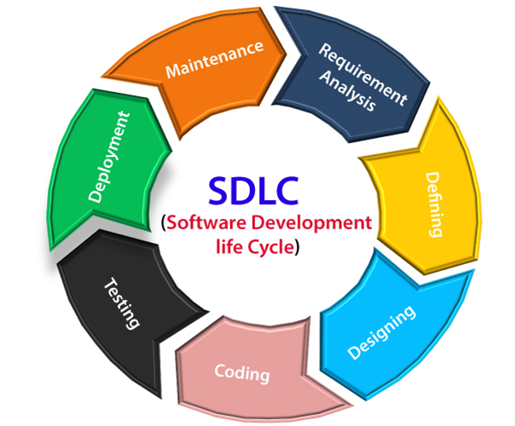
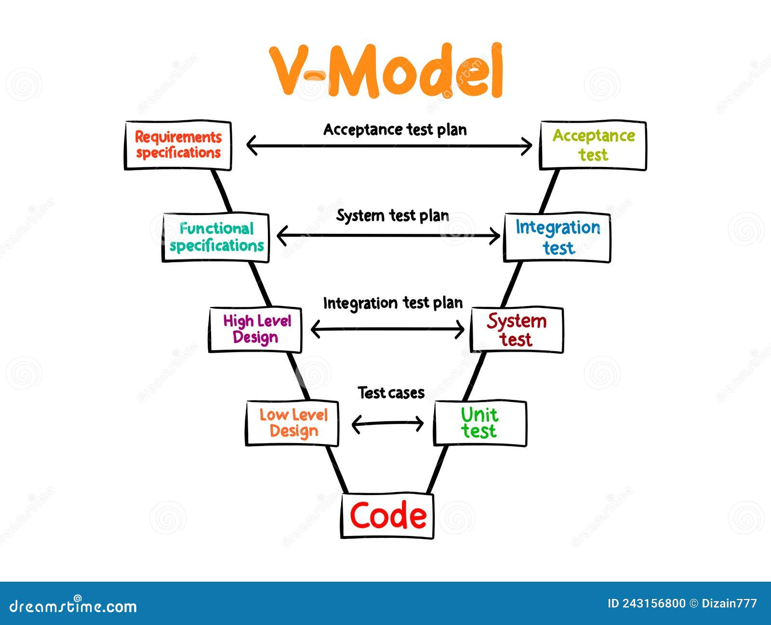
Software Development life cycle (SDLC)

Slide 9
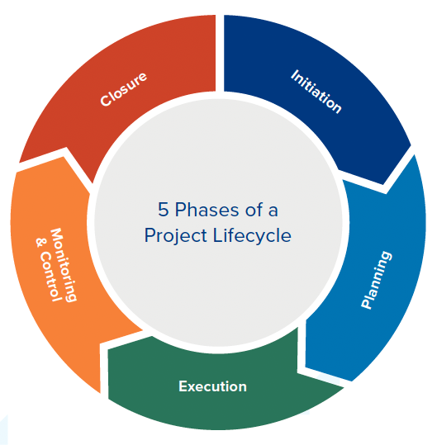
Project lifecycle
Initiation
Planning
Execution
Monitoring and Controlling
Closure

Slide 10
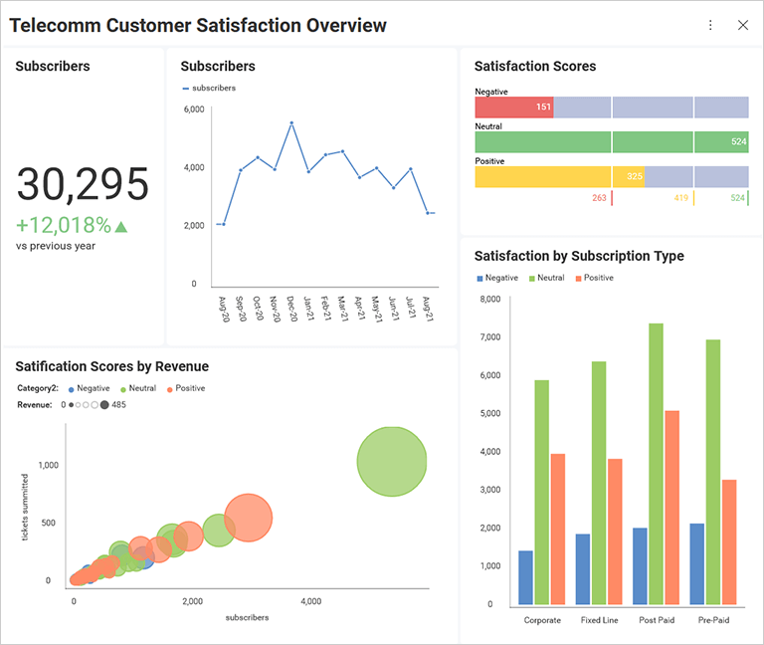
Telecommunication Customer Graphs

Slide 11
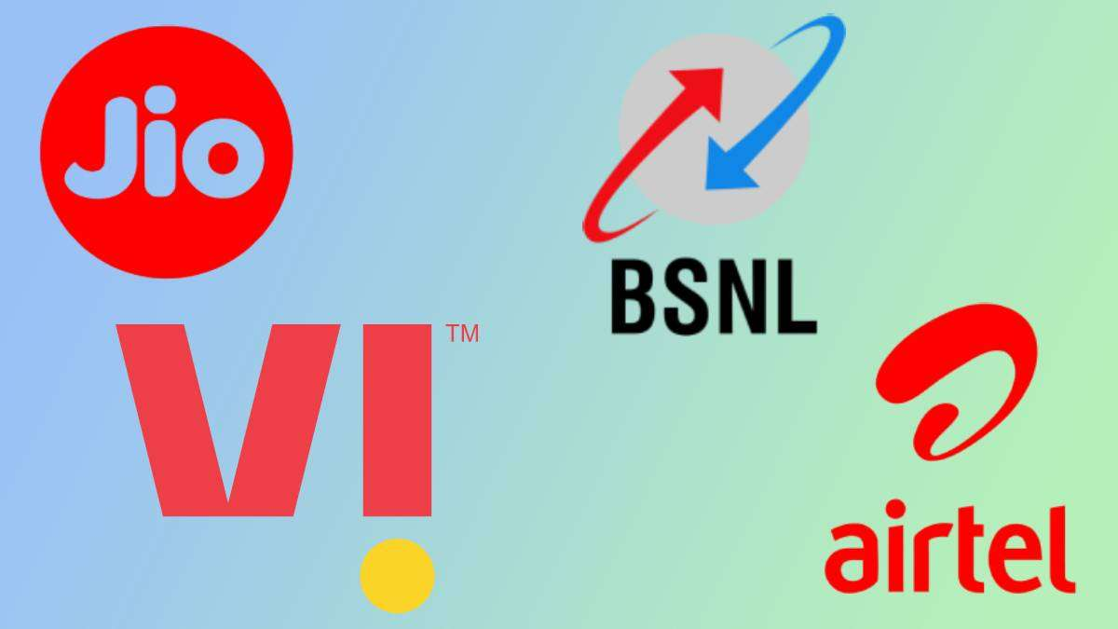
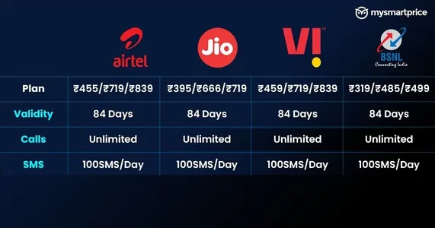
Ideas and More Information

Slide 12
